Slide 1

INTRODUCTION TO NETWORKING

Slide 2
CONTENTS
Unit-I Topologies
Unit-II Network types
Unit-III Network models (TCP/IP and OSI)
Unit-IV Network Devices
Unit-V Network Cables
Unit-VII Subnetting

Slide 3
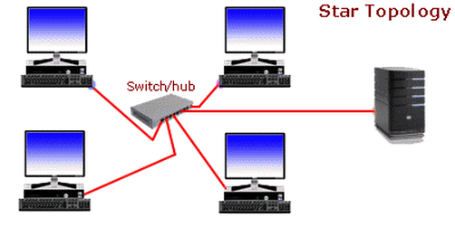
Topologies
Types of topologies
Star topology
Bus topology
Tree topology
STAR TOPOLOGY
Is designed with each node (workstations,printers,laptops,servers etc.) connected directly to a central device called a Switch.

Slide 4
Star topology
Advantages
Easy to install
No disruptions to the network when connecting or removing devices.
Easy to detect faults on the network.
Disadvantages
Requires more cable length than the bus topology.
Its costly to set up

Slide 5
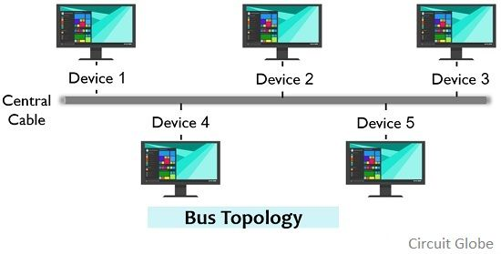
Bus Topology
A bus network is a network topology in which all nodes are connected to a single network cable.
Advantages
Easy to connect a device to the network
Cheaper to set up.
Failure of one station doesn’t affect the rest of the network.
Disadvantages
Additional devices can slow down the network.
High maintenance costs
A break in the back bone can cause the entire network to collapse

Slide 6
Network types
Local Area Network (LAN)
Is simply the type of network where computers are located with in the same building.
Wide Area Network (WAN)
Is a type of network that spans across a large geographical area such as an entire city or country.
Metropolitan Area Network (MAN)
Is the type of network that connects two or more LAN’s via cable or wireless connections. Its a network that is smaller than a WAN but bigger than a LAN.
Personal Area Network (PAN)
Is the type of computer network that enables communication between two devices near a person.
PANs can be wired such as USB or they can be wireless such as infrared, Bluetooth etc.

Slide 7
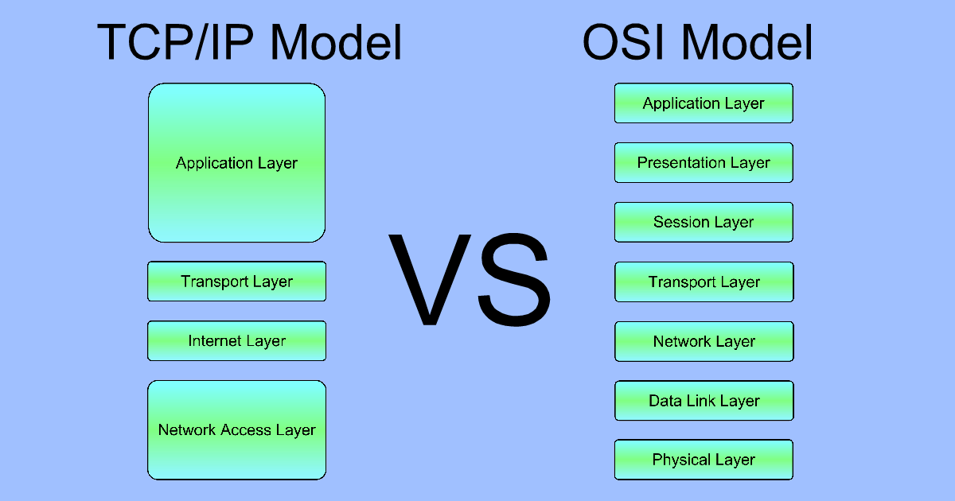
Network Models
A networking model describes the architecture, components, and design used to establish communication between the source and the destination.
Types;
OSI model
TCP/IP model

Slide 8
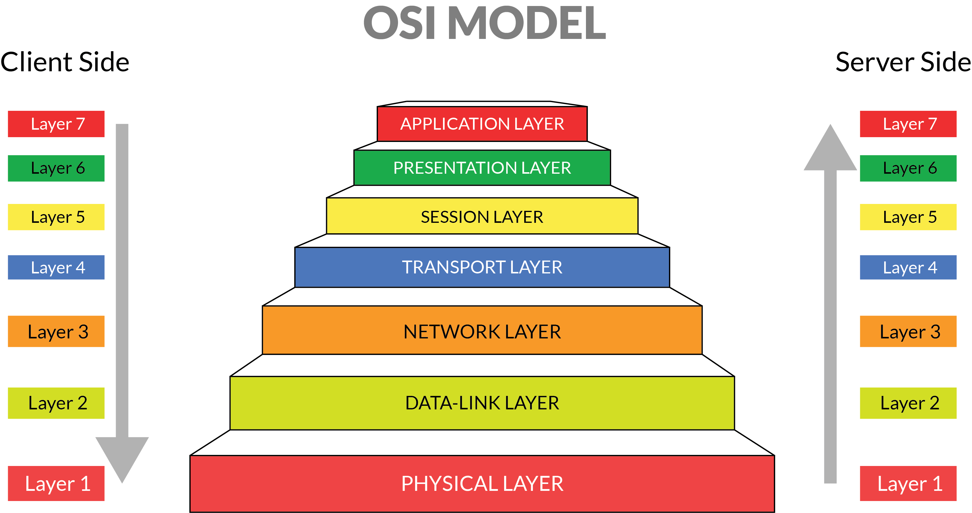
OSI MODEL
OSI stands for; Open Systems Interconnect.

Slide 9
OSI model
There are seven layers found in the OSI model, namely;
Layer 7: Application layer
Allows applications to request for network services.(HTTP,POP3)
Layer 6: Presentation Layer
Converts data so that systems that use different data formats can exchange information i.e.; Application encryption and character encoding.
Layer 5: Session Layer
Establishes Sessions between network applications.
Layer 4: Transport Layer
Provides a reliable delivery of data packets.(UDP,TCP)

Slide 10
OSI Model
Layer 3: Network layer
Handles Routing of data Across networks.(IP addresses)
Layer 2: Data link layer
Describes the basic techniques that networks use to uniquely identify devices on the network.(MAC addresses)
Layer 1: Physical Layer
Describes the Mechanical and electrical details of network components such as cables, connectors and network interfaces.

Slide 11
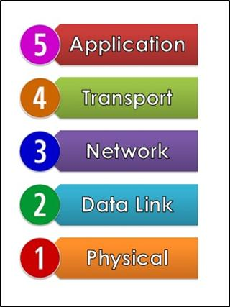
TCP/IP Model
Layer 5: Application layer
Allows applications to request for network services.(HTTP,POP3)
Layer 4 : Transport Layer
Provides a reliable delivery of data packets.(UDP,TCP)
Layer 3: Network layer
Handles Routing of data Across networks.(IP addresses)
Layer 2: Data link layer
Describes the basic techniques that networks use to uniquely identify devices on the network.(MAC addresses)
Layer 1: Physical Layer
Describes the Mechanical and electrical details of network components such as cables, connectors and network interfaces.

Slide 12
TCP/IP Model vs OSI Model

Slide 13
Summary
NOTE;
Layer 5: HTTP/POP3
Layer 4: UDP/TCP
Layer 3: Router (IP addresses)
Layer 2: Switch (MAC addresses)
Layer 1: Cables (Ethernet, Fiber)

Slide 14
UDP and TCP protocols
UDP
User Datagram Protocol (UDP) is a transport layer (Layer 3) protocol and is one of the core members of the internet protocol suite. With UDP computer applications can send messages referred to as datagrams to other hosts on an internet protocol network.
UDP is used for real time services like computer gaming, voice or video communication, live conferences since UDP favors high performance.
UDP permits packets to be dropped instead of processing delayed packets .there is no error checking in UDP so it saves bandwidth.
TCP
Transmission Control Protocol (TCP)was designed to help establish reliable connections on any network.
It establishes a connection before transmitting data and closes the connection after transmitting data.
Keeps data transmissions organized by ensuring that packets are received by the recipient in their intended order.
Assignment: Give 5 differences between UDP and TCP protocols.

Slide 15
Network Devices
Switch
Router
Bridge
Wireless Access Point (WAP)
WiMAX
Modem

Slide 16
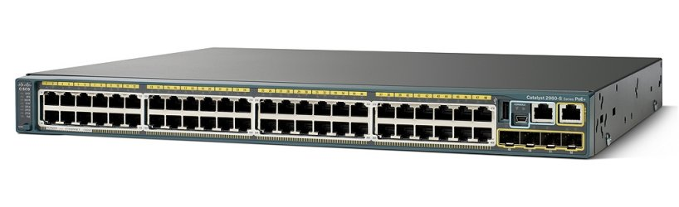
Switch
Is a network device that can connect multiple devices in a LAN e.g. computers, routers, WAPs, printers etc. and operates at the data link layer-Layer 2.
A switch is similar to a hub in that it allows you to connect more than one device and packets received from one port are relayed to other ports. The difference however is that a switch is able to examine the actual contents of the data it receives.

Slide 17
Switch
Data is sent in units called packets that contain the sender and destination address. A switch examines the destination address and repeats the incoming packet only to the port that can deliver the packet to the intended destination. Switches also identify recipients of data packets by use of MAC addresses.
NOTE: A data packet is a unit of data made into a single packet that travels along a given network path.
NB: Media Access Control address (MAC address) is a unique identifier assigned to a network interface card (NIC) for use as a network address.

Slide 18
Roles of a Switch
Learning
Forwarding
Flooding
Learning
For a switch to do its job, it needs to know what devices are connected to each of its ports. More specifically a switch needs to know what MAC addresses are reachable via each of its ports. It does this by simply learning.
If a packet is being sent or received on any of the switch’s ports, the switch examines the sending MAC address in the packet. The switch rightly assumes that if it received a packet from a given MAC address on a given port, the switch can reach that MAC address via that port.

Slide 19
MAC Address table
Port | MAC Address
Computer A 1 | 40-2d-08-8h-84-z7
Computer B 2 | 21-76-3d-7a-f6-16
Computer C 3 | A2-43-c6-n8-98-39
Computer D 4 | 67-de-3f-4t-65-8h
Computer E 5 | 8n-45-87-h7-45-32
Computer X 6 | X3-29-0d-3t-6c-8f
Computer Z 7 | 7d-8f-56-78-3f-3q

Slide 20
Forwarding
A switch simply looks up the destination MAC address with in a packet checks its forwarding Database and sends the packet out through the corresponding port.
NOTE: If a switch receives a packet from computer C on port 3, a switch learns that computer C is reachable on port 3. The switch adds the information to the MAC address table which is also referred to as the forwarding database.
NOTE: The switch will eventually receive packets from all its ports and will associate the senders MAC address with each port.

Slide 21
Flooding
When a switch receives a packet that is untended for a MAC address that isn’t in the switch’s Forwarding database (MAC Address table),The switch has no option but to act like a Hub. The switch simply forwards the packet to all available ports and this is called Flooding .
The packets will be forwarded even to ports for which the switch has already learned their Mac address. This is necessary because a single port can be a pathway to more than one MAC address as is the case when the port is connected to another switch.
Flooding in a network may increase network traffic thus slowing down the network, so the switch implements a mechanism to stop the flooding by use of the Spanning Tree Protocol.
NB; Spanning Tree Protocol is a Layer 2 network protocol used to prevent looping within a network topology.

Slide 22
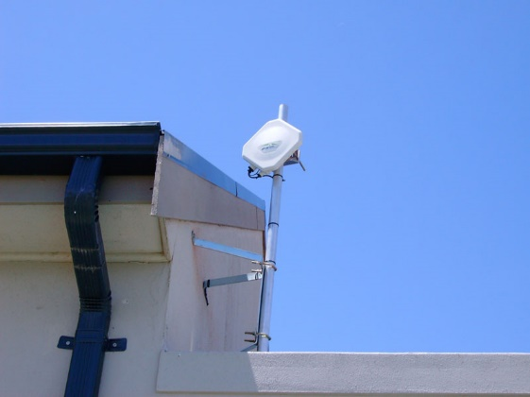
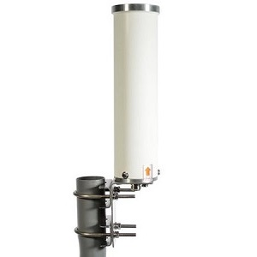
WiMAX
World Wide interoperability for Microwave access (WiMAX), is a telecommunications technology aimed at providing wireless data over long distances, from point to point links to cellular type access.
Its used to provide wireless access and connect WLAN hotspots to the internet.

Slide 23
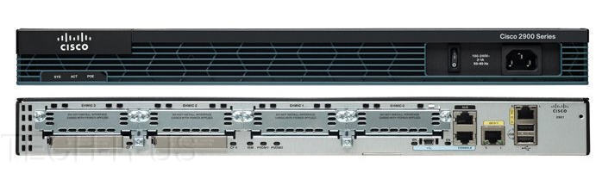
Router
A router is a device that connects two or more Local Are Networks (LANs) via the internet.
Its role;
Managing traffic between these networks by forwarding data packets to their intended IP addresses.

Slide 24
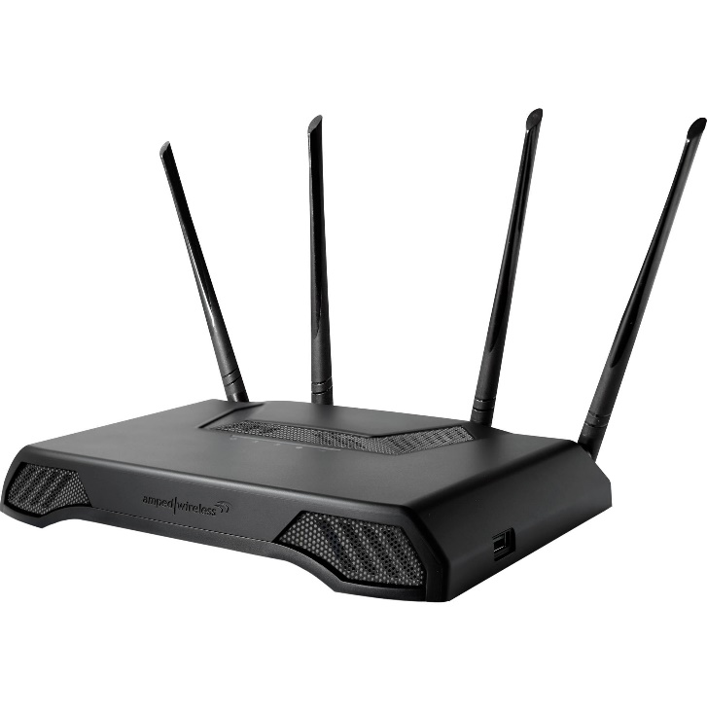
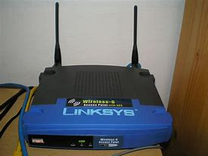
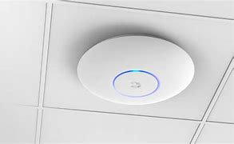
Wireless Access Point
An access point is a device that creates a wireless local area network, or WLAN, usually in an office or large building. A Wireless access point connects to a wired router, switch, or hub via an Ethernet cable, and projects a Wi-Fi signal to a designated area.

Slide 25
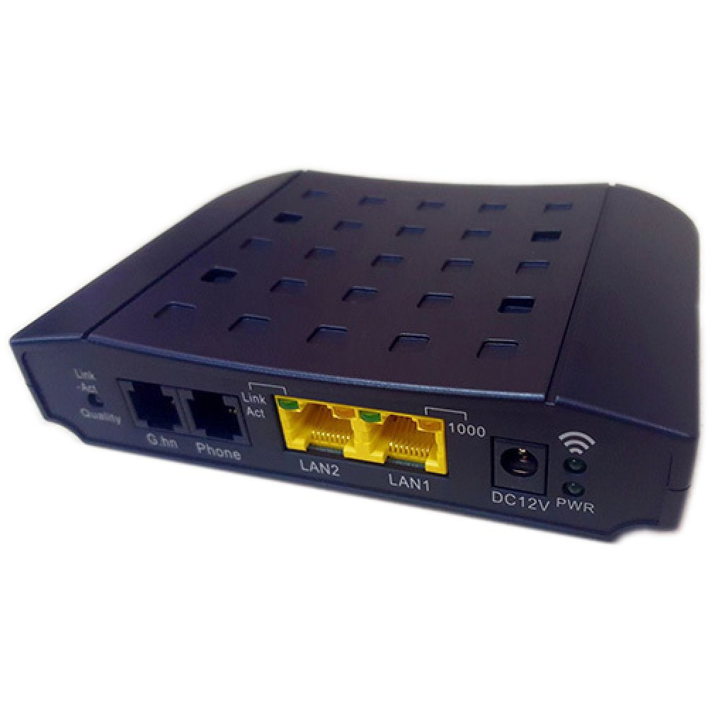
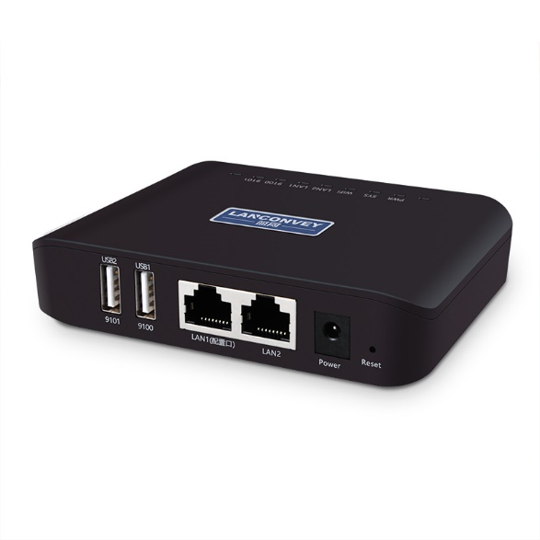
Bridge
A bridge is a device that is very similar to a switch but with fewer ports usually just 2 ports.
A bridge works at the Data link layer (Layer 2) of the OSI model. It inspects incoming traffic and decide whether to forward it or filter it. Each incoming Ethernet frame is inspected for destination MAC address.

Slide 26
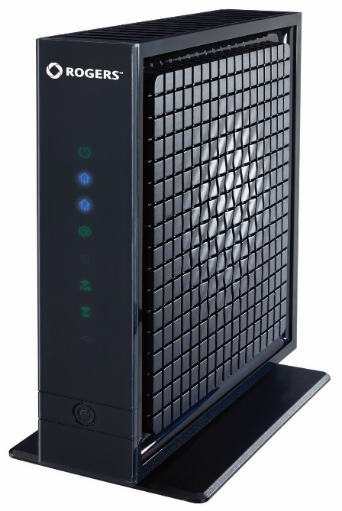
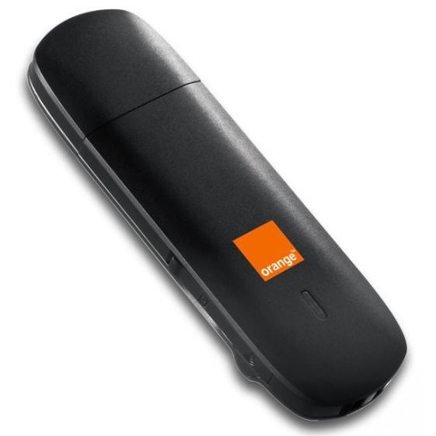
Modem
A modulator-demodulator, or simply modem, is a computer hardware device that converts data from a digital format into a format suitable for an analog transmission.
Modems bring the Internet to your home.
A modem is a device that connects your home, usually through a coaxial cable connection or fibre optic, to your Internet service provider (ISP), like Xfinity. The modem takes signals from your ISP and translates them into signals your local devices can use, and vice versa.

Slide 27
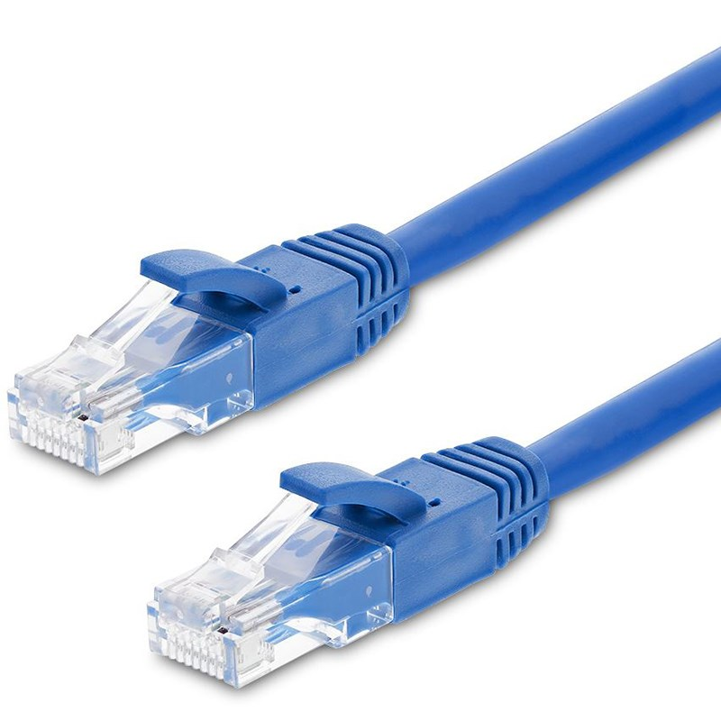
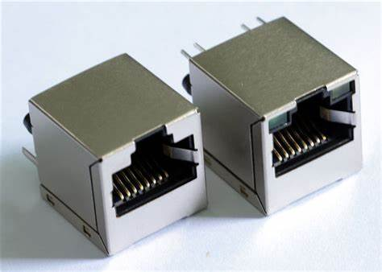
Network Cables
Ethernet cables
Ethernet cables are used to connect devices to a local network and are used to provide an internet connection. They plug into Ethernet ports on a variety of devices. They plug into Ethernet ports on a variety of devices.

Slide 28
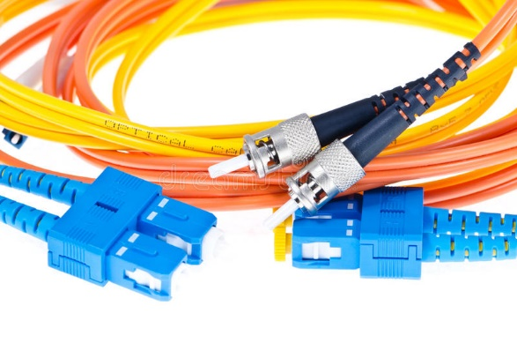
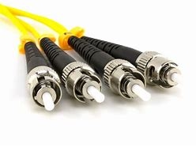
Fiber Optic Cables
Fiber optics is used for long-distance and high-performance data networking. It is also commonly used in telecommunication services, such as internet, television and telephones.

Slide 29
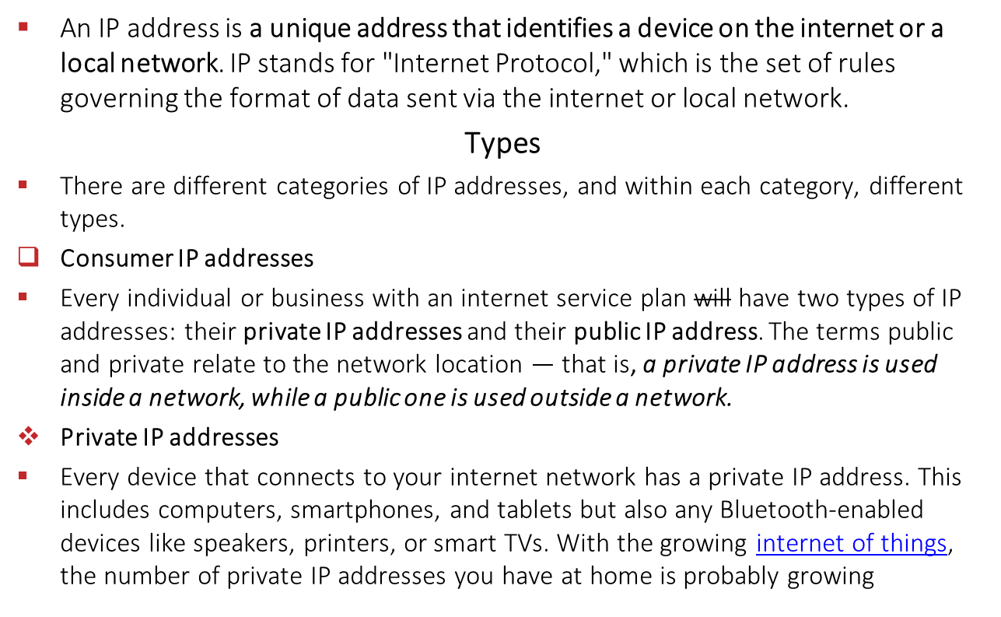
IP Addresses

Slide 30
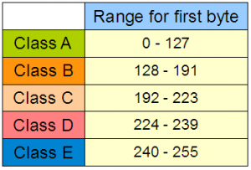
IP Address Classes
A network mask helps you know which portion of the address identifies the network and which portion of the address identifies the host. Class A, B, and C networks have default masks, also known as natural masks, as shown here:
Subnet Mask
Class A: 255.0.0.0
Class B: 255.255.0.0
Class C: 255.255.255.0

Slide 31
IP CLASSES
Class A Network
This IP address class is used when there are a large number of hosts.
In a Class A type of network, the first 8 bits (also called the first octet) identify the network, and the remaining have 24 bits for the host into that network.
An example of a Class A address is 102.168.212.226. Here, “102” helps you identify the network and 168.212.226 identify the host.
Class A addresses 127.0.0.0 to 127.255.255.255 cannot be used and is reserved for loopback and diagnostic functions.
Example;
10.0.0.1

Slide 32
Class B
In a B class IP address. this IP address, the class decimal number that can be between 128 to 191. The number 127 is reserved for loopback, which is used for internal testing on the local machine. The first 16 bits (known as two octets) help you identify the network. The other remaining 16 bits indicate the host within the network.
An example of Class B IP address is 168.212.226.204, where *168 212* identifies the network and *226.204* helps you identify the network host.
Example;
150.150.0.1

Slide 33
CLASS C
Class C is a type of IP address that is used for the small network. In this class, three octets are used to indent the network. This IP ranges between 192 to 223.
In this type of network addressing method, the first two bits are set to be 1, and the third bit is set to 0, which makes the first 24 bits of the address them and the remaining bit as the host address. Mostly local area network used Class C IP address to connect with the network.
Example for a Class C IP address:
192.168.178.1
NOTE:

Slide 34
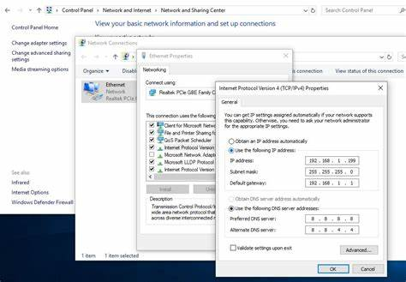
How to Set An IP Address
Windows + R (Run command)
Type Ncpa.cpl
Double click network Adapter
Double click IPv4
Set IP address and Subnet mask

Slide 35
Error Messages
Ping is a network tool mainly used to test whether a host is reachable across an IP network and to measure the round-trip time for packets sent from the source to the destination computer.
Ping works by sending Internet Control Message Protocol (ICMP) echo request packets to the destination host and waits for an ICMP response. It also measures the time it takes for the packets to return.

Slide 36
When you are unable to “ping” the destination host either by IP Address or by hostname, you should pay close attention to the results provided by ICMP. Different messages indicate different types of issues. The three most common error messages that you will see are as follows:
Destination Host Unreachable
Request Timed Out
Ping Request Could Not Find Host

Slide 37
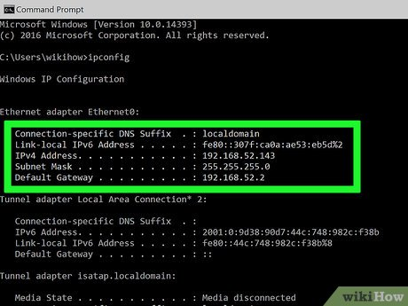
IP Config
(Internet Protocol CONFIGuration) A command line utility that is used to display and manage the IP address assigned to the machine. In Windows, typing ipconfig without any parameters displays the computer's currently assigned IP, subnet mask and default gateway addresses.

Slide 38
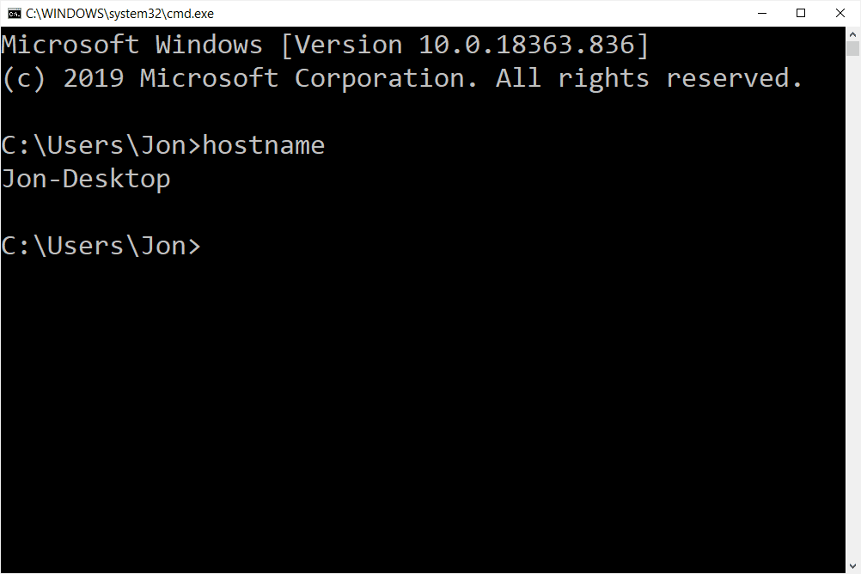
Hostname
Hostname command displays the name of the current host system. Only users with root user authority can set the host name.

Slide 39
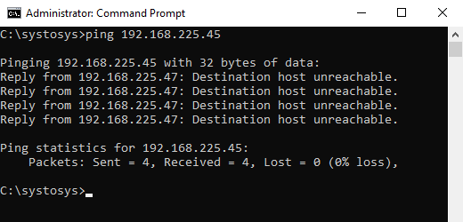
Destination Host Unreachable
The Destination Host Unreachable error message indicates that a route to the destination node cannot be found.
The Destination Host Unreachable error tells that the ping packets from your computer cannot find a route to the destination IP address(destination host).

Slide 40
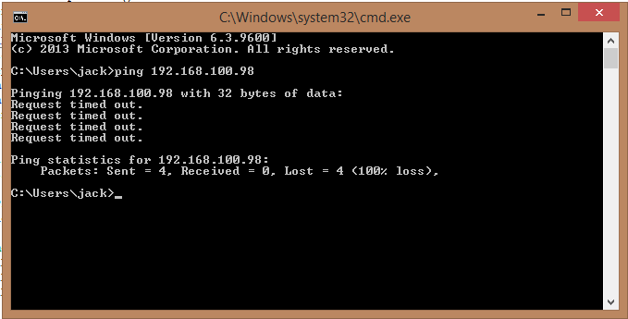
Request Timed Out
In most cases, a "Request Timed Out" message is caused by a firewall blocking the connectivity.
We disable Firewall Using the Command Firewall.cpl
Run command (Win + R) then type Firewall.cpl

Slide 41
Ping request could not find Host
You receive this error message due to the wrong DNS information stored on your computer. When you type the URL of a website on a browser, your computer needs to know the IP address of the website to load it.
Your computer does it by a process called DNS lookup. DNS lookup process converts the website host address into the respective IP address. Domain Name System (DNS) helps your computer in the DNS lookup process.
If the DNS information stored on your computer fails to complete the DNS lookup process, you will receive the error message Ping request could not find host. Please Check the Name and Try Again.

Slide 42
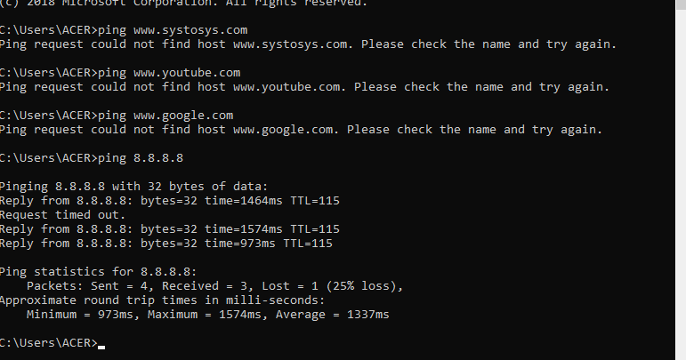

Slide 43
SUBNETTING
Subnetting allows you to create multiple logical networks that exist within a single Class A, B, or C network. If you do not subnet, you are only able to use one network from your Class A, B, or C network, which is unrealistic.
Each data link on a network must have a unique network ID, with every node on that link being a member of the same network. If you break a major network (Class A, B, or C) into smaller subnetworks, it allows you to create a network of interconnecting subnetworks.
In order to subnet a network, extend the natural mask with some of the bits from the host ID portion of the address in order to create a subnetwork ID.

Slide 44
What is a packet?
It turns out that everything you do on the Internet involves packets. For example, every Web page that you receive comes as a series of packets, and every e-mail you send leaves as a series of packets. Networks that ship data around in small packets are called packet switched networks.
On the Internet, the network breaks an e-mail message into parts of a certain size in bytes. These are the packets. Each packet carries the information that will help it get to its destination -- the sender's IP address, the intended receiver's IP address, something that tells the network how many packets this e-mail message has been broken into and the number of this particular packet. The packets carry the data in the protocols that the Internet uses: Transmission Control Protocol/Internet Protocol (TCP/IP). Each packet contains part of the body of your message. A typical packet contains perhaps 1,000 or 1,500 bytes.

Slide 45
Each packet is then sent off to its destination by the best available route -- a route that might be taken by all the other packets in the message or by none of the other packets in the message. This makes the network more efficient. First, the network can balance the load across various pieces of equipment on a millisecond-by-millisecond basis. Second, if there is a problem with one piece of equipment in the network while a message is being transferred, packets can be routed around the problem, ensuring the delivery of the entire message.
Depending on the type of network, packets may be referred to by another name:
frame
block
cell
segment

Slide 46
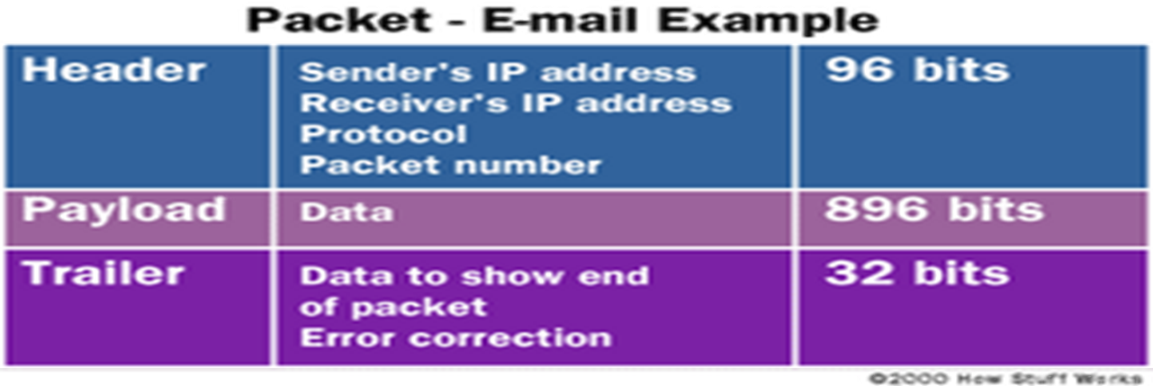
Header - The header contains instructions about the data carried by the packet. These instructions may include:
Length of packet (some networks have fixed-length packets, while others rely on the header to contain this information)
Synchronization (a few bits that help the packet match up to the network)
Packet number (which packet this is in a sequence of packets)

Slide 47
Protocol (on networks that carry multiple types of information, the protocol defines what type of packet is being transmitted: e-mail, Web page, streaming video)
Destination address (where the packet is going)
Originating address (where the packet came from)
Payload - Also called the body or data of a packet. This is the actual data that the packet is delivering to the destination. If a packet is fixed-length, then the payload may be padded with blank information to make it the right size.

Slide 48
Points to Note
Unicast – Communication from one host to another host only.
Broadcast – Communication from one host to all the hosts in the network.
Multicast – Communication from one host to few hosts only.

Slide 49
Trailer - The trailer, sometimes called the footer, typically contains a couple of bits that tell the receiving device that it has reached the end of the packet. It may also have some type of error checking. The most common error checking used in packets is Cyclic Redundancy Check (CRC).

Slide 50
END

